Slide 1
Digital Portfolio
STUDENT NAME: RAMAN V
REGISTER NO AND NMID: 2428c0235 and 2264E4DE8F0E260A24E4780685A849BE
DEPARTMENT: B SC [AI&ML]
COLLEGE: PIONEER COLLEGE OF ARTS AND SCIENCE

Slide 2
PROJECT TITLE
TRAVEL PLANNER WEBSITE

Slide 3


AGENDA
Problem Statement
Project Overview
End Users
Tools and Technologies
Portfolio design and Layout
Features and Functionality
Results and Screenshots
Conclusion
Github Link
3/21/2024 Annual Review

Slide 4

PROBLEM STATEMENT
Travellers often struggle to plan trips efficiently.
They face issues like:
Finding attractions and activities in a city.
Budgeting travel costs.
Organizing a multi-day itinerary.
Integrating maps and travel routes.
Goal: Create a web application to help users plan trips seamlessly, with destination info, itinerary creation, and budgeting tools.

Slide 5

PROJECT OVERVIEW
Name: Travel Planner Website
Type: Web application
Purpose: To provide an interactive platform for planning trips, including destinations, accommodations, maps, and cost estimates.
Target audience: Travellers, travel enthusiasts, students, and professionals.
Name: Travel Planner Website
Type: Web application
Purpose: To provide an interactive platform for planning trips, including destinations, accommodations, maps, and cost estimates.
Target audience: Travellers, travel enthusiasts, students, and professionals.

Slide 6

WHO ARE THE END USERS?
Casual travellers looking for quick trip ideas.
Frequent business travellers needing structured itineraries.
Families planning vacations together.
Travel bloggers or influencers needing organized travel content.

Slide 7

TOOLS AND TECHNIQUES
Front-end: HTML, CSS, JavaScript, Bootstrap/Tailwind
Back-end: Node.js with Express or Python Flask
Database: MongoDB, Firebase, or MySQL
APIs: Google Maps API, Weather API, Travel info API
Optional Tools: Figma for UI/UX design

Slide 8
POTFOLIO DESIGN AND LAYOUT
Clean, responsive design suitable for desktop and mobile.
Navigation bar with categories: Destinations, Itinerary, Budget, Maps.
Hero section with a search bar for destinations.
Cards for each destination with quick info and links.
8

Slide 9
FEATURES AND FUNCTIONALITY
User Accounts: Save trip plans.
Destination Info: Weather, attractions, hotels.
Custom Itinerary Builder: Add activities, restaurants, and sightseeing.
Budget Estimator: Calculate costs for transportation, accommodation, and activities.
Map Integration: Display routes and locations on a map.
Recommendations: AI or rules-based suggestions for destinations and activities.
Optional Features: Chatbot assistance, social sharing, travel alerts.

Slide 10
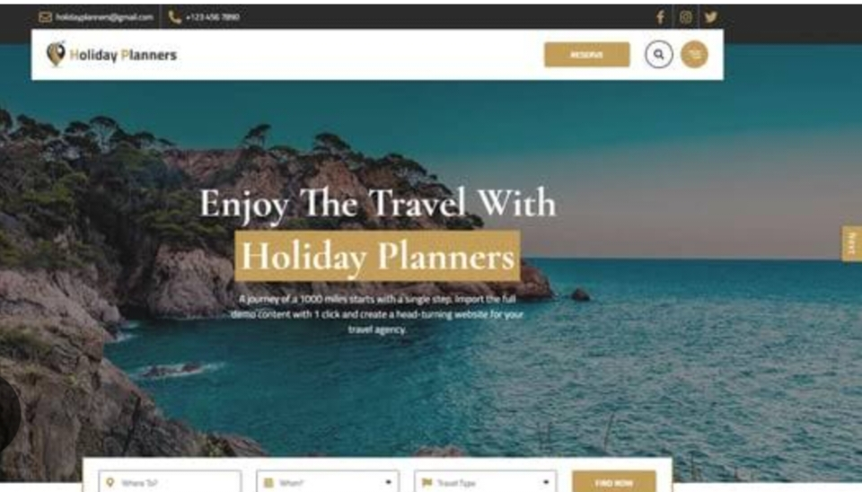

RESULTS AND SCREENSHOTS
3/21/2024 Annual Review
10

Slide 11
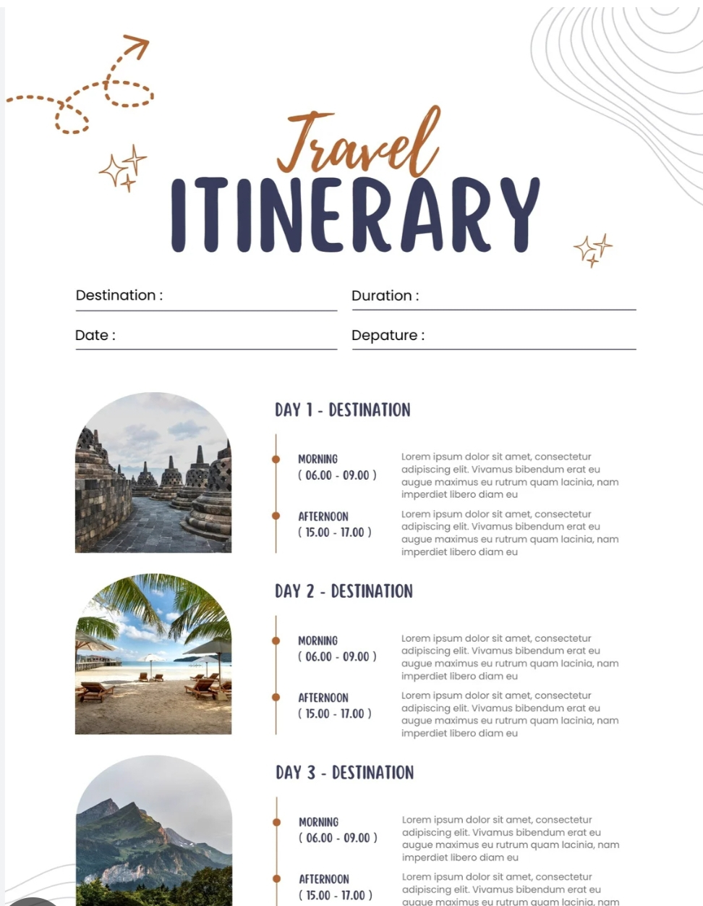
destination cards

Slide 12
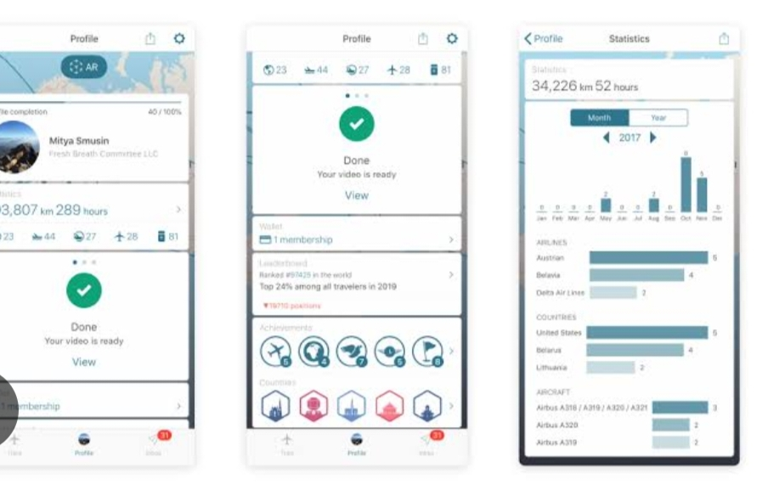
time and payment map

Slide 13
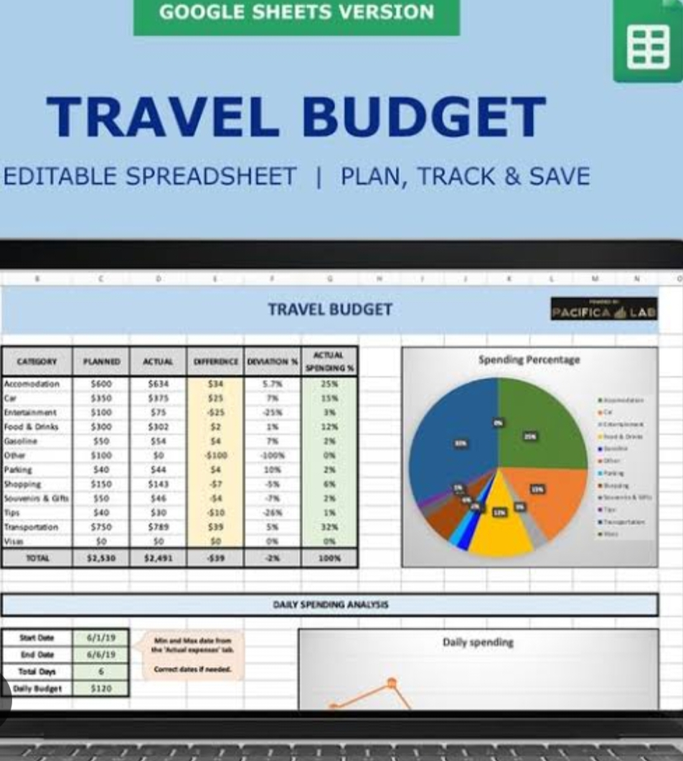
budget calculator

Slide 14
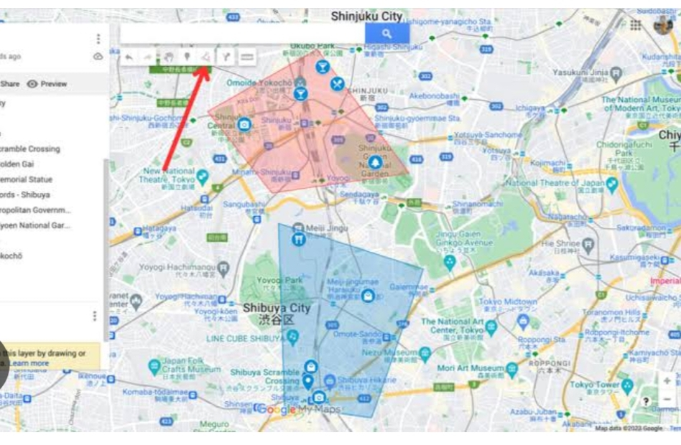
map integration

Slide 15
CONCLUSION
Travel Planner Website simplifies trip planning.
Enhances user experience with interactive features.
Provides centralized information for travellers.
Demonstrates skills in full-stack development, UI/UX design, and API integration.
15

Slide 16
GITHUB LINK
https://github.com/Raman-Vraman

